Slide 1
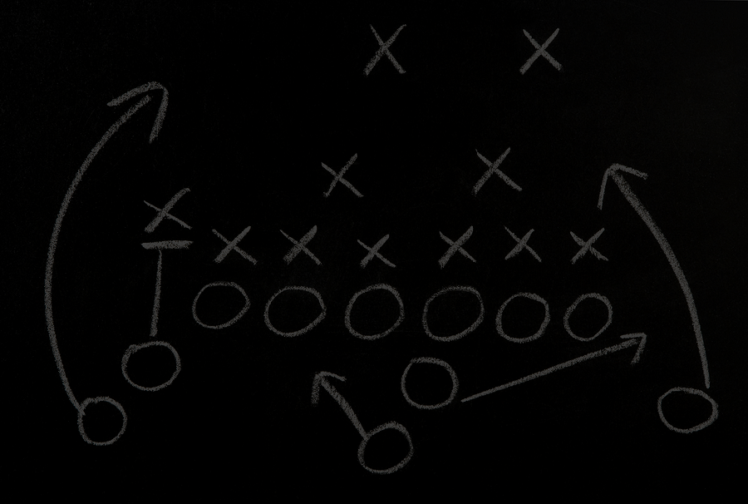
Points Gained: Evaluating NFL Performance
Timothy C.Y. Chan†, Craig Fernandes†, Martin L. Puterman‡
† University of Toronto, Department of Mechanical and Industrial Engineering
‡ University of British Columbia, Sauder School of Business

Slide 2

Research Goal
To estimate the value of field positions in the NFL in order to:
Gain insight on how strong and weak teams differ
Derive a novel ranking methodology based on performance in particular game states
Evaluate plays to quantify what game aspects most contribute to a team’s performance

Slide 3

Football Basics
4 Downs
Field Goal
Safety
Touchdown

Slide 4
Literature Review
Developing value functions
Attempted to fit a linear value function based on the down and yard line¹
Utilized dynamic programming to find values for down, yard line and yards to go combinations²
Utilized multinomial logistic regression³
Evaluating plays using a value function
Discussed metrics to evaluate the efficiency of individual plays to solve tactical decision problems and analyze players^{3,4}
¹(Carroll, Palmer and Thorn, 1988)
²(Carter and Machol, 1971, Romer, 2002, Cabot, Sagarin and Winston, 1981, Goldner, 2012, 2017)
³(Yurko, Ventura and Horowitz, 2018)
⁴(Winston, 2009, Burke, 2009)

Slide 5
Data
NFLsavant.com: play-by-play data for the 2013-14 to 2016-17 regular NFL seasons – created by Daren Willman
1034 Games & 164,299 Plays
Raw Variables: year, quarter, down, yards to go for first down, yard line, offensive team, defensive team and play type

Slide 6
Value Function Definition
Infinite horizon Markov reward process⁶
Let V(d,y) be the expected margin of victory for the offensive team on down d and yard line y in an infinite length game between symmetric teams
Let p_{(dy),(d’y’)} be the probability of transitioning from state (d,y) to state (d’,y’)
Let p_{(dy),(d’y’)} be the probability of a turnover for a play starting at state (d,y) and resulting in the defense receiving possession at state (d’,y’)
Note: kick offs are denoted as 0th downs and yard lines are denoted 1 to 99 (99th yard line is one yard away from a touchdown)
TO
⁶(Puterman, 1994)

Slide 7
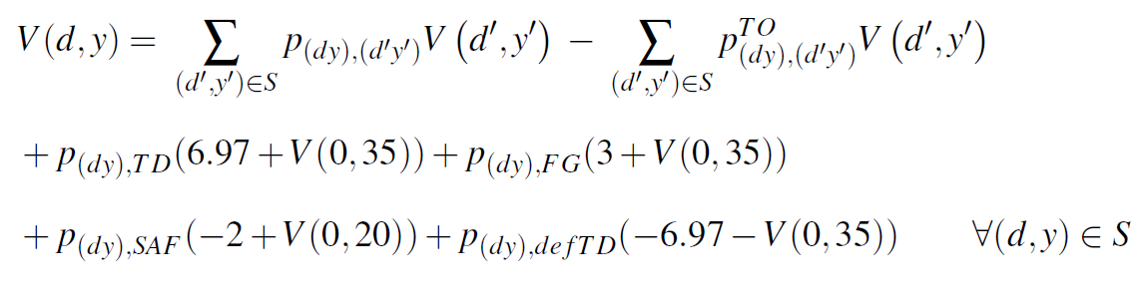
Value Function
V(d,y) can be calculated by taking into account the values of all the different states the current state may transition to including turnovers and scoring events
Regular plays
Turnovers
Accounting for kickoffs
Scoring events

Slide 8
Empirical Transition Probabilities
Bootstrapping approach
Isolate all plays starting at a particular (d,y) pair
Sample with replacement 1000 times and record the proportion of times each next state (d’,y’) is drawn
For example, if we consider state (1,35) and in our sample the next state (2,40) occurs 100 times, the probability of advancing from (1,35) to (2,40) is equal to 0.10
Repeated for every down and yard line pair

Slide 9
Estimating the Value Function
(1) Generate an instance of the transition probability matrix
(2) Solve the value function equation
(3) Repeat steps (1) – (2) 30 times, each time drawing new
transition probabilities
(4) Construct 95% confidence intervals for each V(d,y)

Slide 10
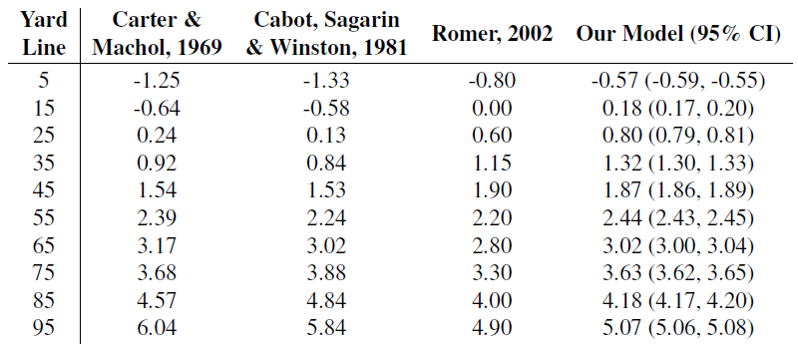
Value Function Results on 1st Down
Teams are now better at scoring from their own end
Due to symmetry, the value of being in the red zone is reduced because the kickoff after a scoring event places the receiving team in a better position

Slide 11
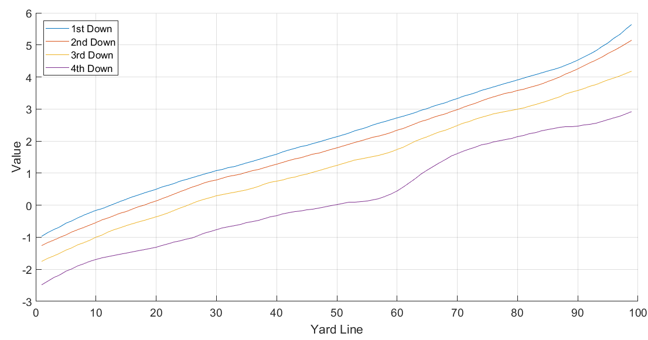
Value Function by Down
1st to 2nd Down: lose 0.4 points
2nd to 3rd Down: lose 0.6 points
3rd to 4th Down: lose 0.7 – 1.3 points
Increase on 4th down at the 60 yard line (FG region)

Slide 12
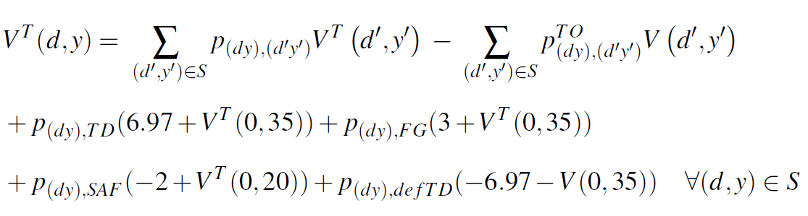
Team Value Functions
Let V^{T}(d,y) be the value function for team T
Assume the opposing team follows the league-wide value function

Slide 13
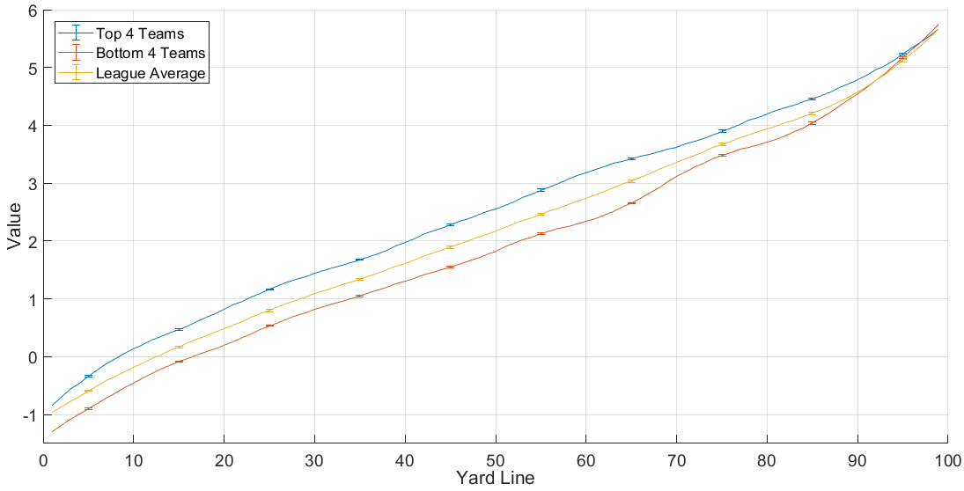
Top vs Bottom Teams
Biggest difference between the top and bottom teams occurs in the beginning and middle of the field
Value functions converge towards the end zone, indicating that both cohorts perform roughly the same in this part of the field

Slide 14
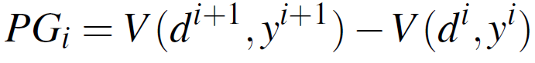
Points Gained
What follows is inspired by Broadie’s (2008, 2012) strokes gained metric in golf, Winston’s (2009) play value and Yurko et Al’s (2018) expected points per play metrics in football
Suppose the i^{th} play of a game starts at (d^{i},y^{i}) and ends at (d^{i+1},y^{i+1}), then
Points gained (PG) represents the change in the margin of victory as a consequence of play i

Slide 15
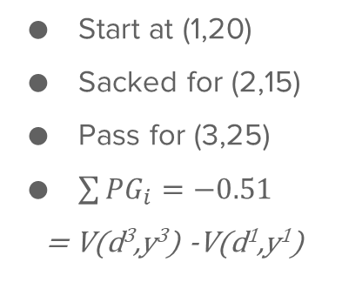
Points Gained per Possession
Start at (1,20)
Sacked for (2,15)
Pass for (3,25)
$\sum{{PG}_{i}=−0.51}$
= V(d³,y³) -V(d¹,y¹)
0.50
PG₁ = -0.69
-0.19
1
3
PG₂ = 0.18
2
-0.01

Slide 16
Points Gained per Game
The PG for a game represents the change in the expected margin of victory from the opening kickoff until the last play
Since a team is equally likely to receive or kick the opening kickoff, the expected value of the starting game state is zero
Hence, the PG for a game can be interpreted simply as a team’s expected margin of victory for a game

Slide 17
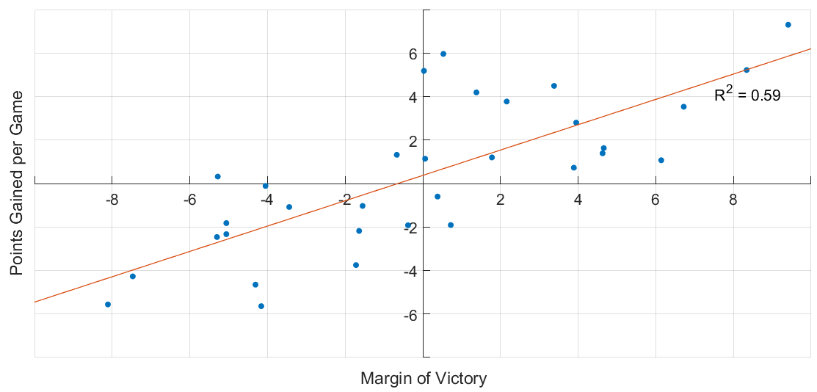
Points Gained per Game
A positive correlation (R² = 0.59) exists between the observed average margin of victory for each team and the average PG per game for each team

Slide 18
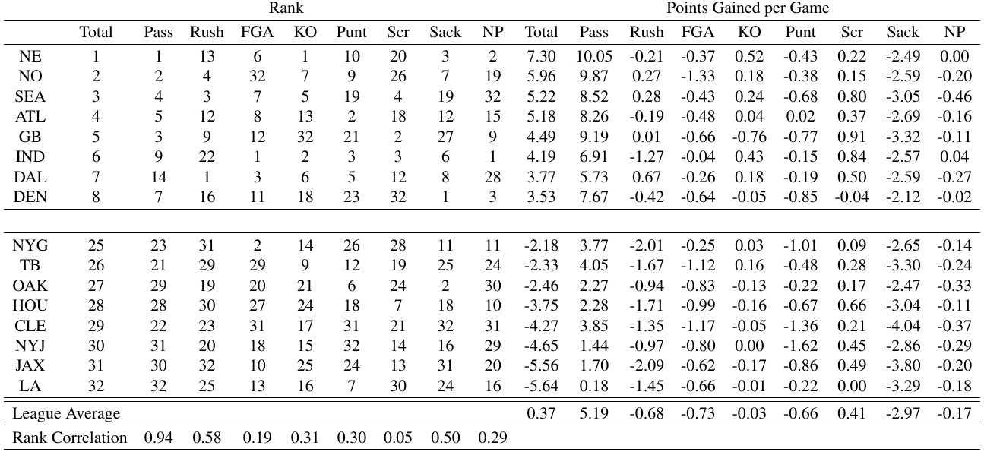
Points Gained by Play Type

Slide 19
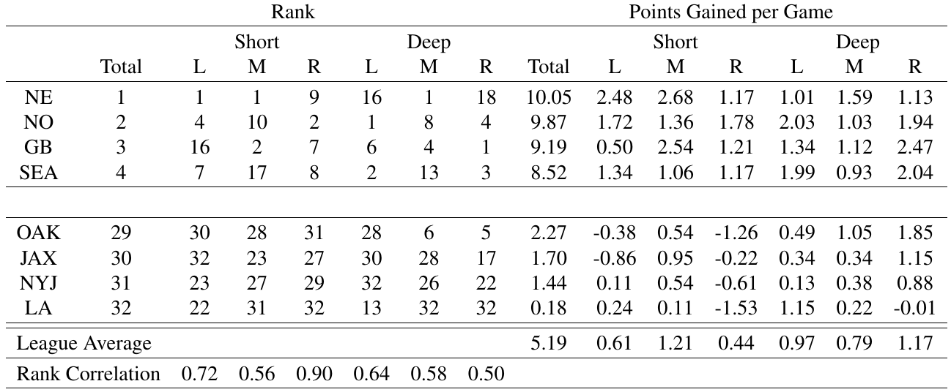
Points Gained by Pass Type
PG on long passes contribute 56.5%
On short passes, PG over the middle dominates
Short passes for top (bottom) four teams contribute 50% (-43%)
NE excels on passes over the middle

Slide 20
Conclusion
Football value functions can be derived by modelling football as an infinite horizon Markov reward process
Top teams generate the most value in their end and the middle of the field
Passing plays contribute the most to overall performance
Short passes account for the majority of top team’s success and worst team’s poor performance
Points gained provides other insights including which teams perform the best in the “clutch” and identifies which aspects of the game team’s should focus on improving

Slide 21
References
Broadie, M. (2008): “Assessing golfer performance using golfmetrics,” in D. Crews and R. Lutz, eds., Science and Golf V: Proceedings of the World Scientific Congress of Golf, Mesa, Arizona: Energy in Motion Inc., 253–262.
Broadie, M. (2012): “Assessing golfer performance on the pga tour,” Interfaces, 42, 116–146.
Burke, B. (2009): “Expected point values,” URL http://archive.advancedfootballanalytics.com/2009/12/expected-point-values.html.
Cabot, V., J. Sagarin, and W. Winston (1981): “A stochastic game model of football,” Unpublished manuscript.
Carroll, B., P. Palmer, and J. Thorn (1988): The Hidden Game of Football, New York, New York: Warner Books.
Carter, V. and R. E. Machol (1971): “Operations research on football,” Operations Research, 19, 541–545.
Goldner, K. A. (2012): “A markov model of football: Using stochastic processes to model a football drive,” Journal of Quantitative Analysis in Sports, 8.
Goldner, K. A. (2017): “Situational success: Evaluating decision-making in football,” in T. B. S. J. Albert, M. E. Glickman and R. H. Koning, eds., Handbook of Statistical Methods and Analyses in Sports, Boca Raton, Florida: CRC Press, chapter 8, 183198.
Pelechrinis, K.,W.Winston, and J. Sagarin (2018): “Evaluating nfl plays: Expected points adjusted for schedule,”.
Puterman, M. L. (1994): Markov Decision Processes: Discrete Stochastic Dynamic Programming, John Wiley & Sons.
Romer, D. (2002): “It’s fourth down and what does the bellman equation say? A dynamic-programming analysis of football strategy,” National Bureau of Economic Research Working Paper 9024.
Winston, W. (2009): Mathletics, Princeton University Press.
Yurko, R., S. L. Ventura, and M. Horowitz (2018): “nflwar: A reproducible method for offensive player evaluation in football,” .

Slide 22



Timothy C.Y. Chan; tcychan@mie.utoronto.ca
Craig Fernandes; craig.fernandes@mail.utoronto.ca
Martin L. Puterman; martin.puterman@sauder.ubc.ca

Slide 23
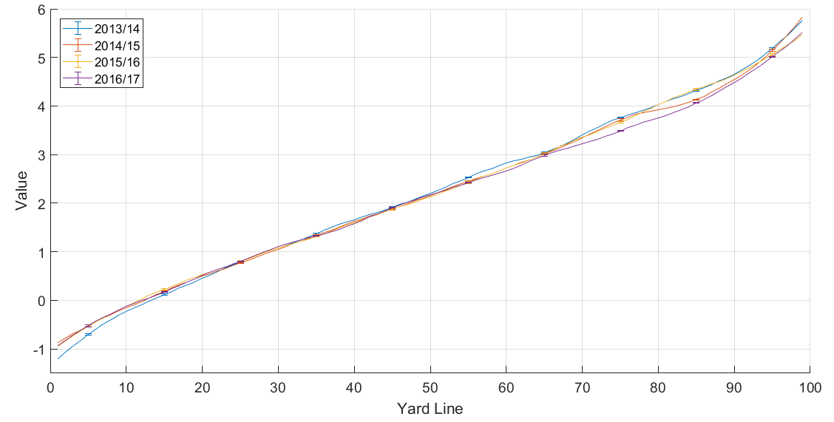
Value Function by Season
Rule change (2016): touchback line moved from the 20 to the 25
Rule change (2015): 1pt conversion line moved from the 98 to the 85

Slide 24
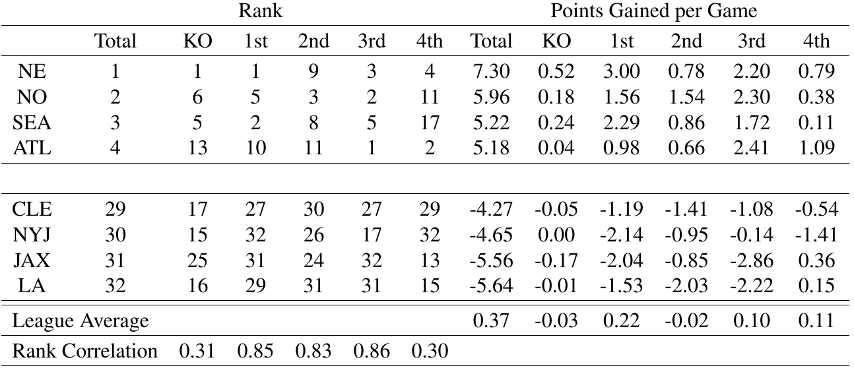
Points Gained by Down
On average, teams gain the most on first down
NE excels on all downs except 2nd
NO, SEA & ATL gain the most either on 1st or 3rd down
Overall performance is highly correlated with the first three downs

Slide 25
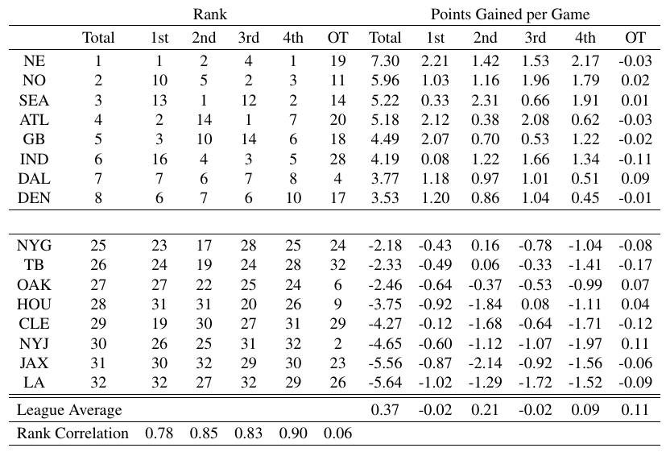
Points Gained by Quarter
On average, PG is only positive in the 2nd and 4th quarters
Top eight teams gain points in all quarters while the bottom four lose points
NE is ranked highly in all four quarters
DAL & DEN are consistently ranked across all quarters
Other teams exhibit more variability

